Slide 1
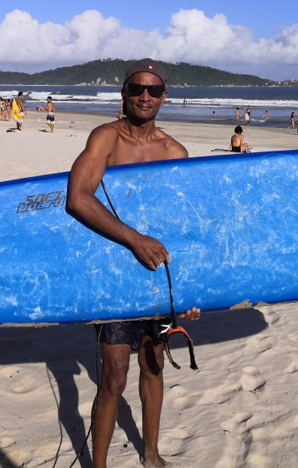
Slide Title 4
Spending as Much Time as Possible on the Beach: Reflections on an Academic Career
John Domingue @johndmk
Knowledge Media Institute, The Open University
http://people.kmi.open.ac.uk/domingue/
ISWC PhD Symposium November 7th 2023, Athens

Slide 2
Agenda
Basic info
Context
Highlights
John’s tips – experiential rather than scientific
No claim that this is a perfect or good career!

Slide 3
Basic Info

Slide 4
Basic Info
1980-1983 BSc (Hons) (Computer Science), University of Warwick.
1983-1987 PhD (Artificial Intelligence), The Open University.
1987-1995 Research Fellow in the Human Cognition Research Laboratory (HCRL) in the Department of Psychology (Assistant Prof I/Research)
1995-1998 Research Fellow in the Knowledge Media Institute (Assistant Prof II/Research)
1998-2008 Senior Research Fellow (Associate Prof/Research)
1999 Post made permanent.
2008 Professor in Computer Science
2015-2022 Director of the Knowledge Media Institute, The Open University.

Slide 5
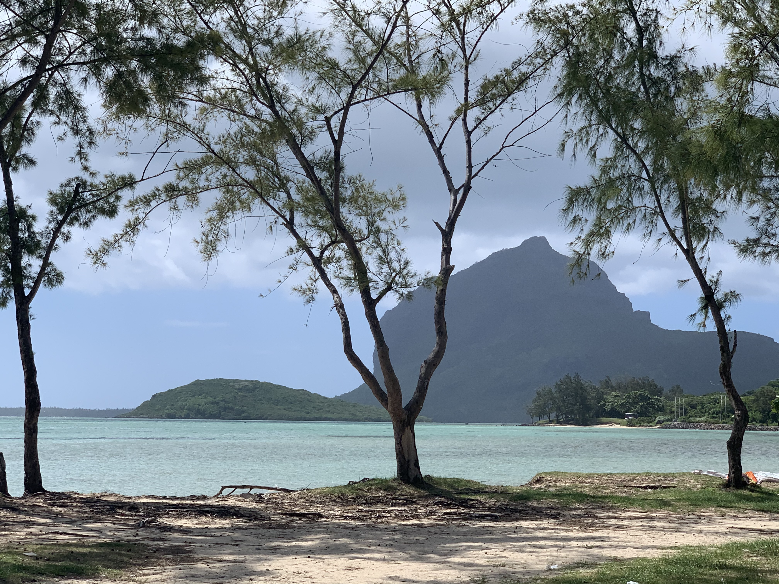
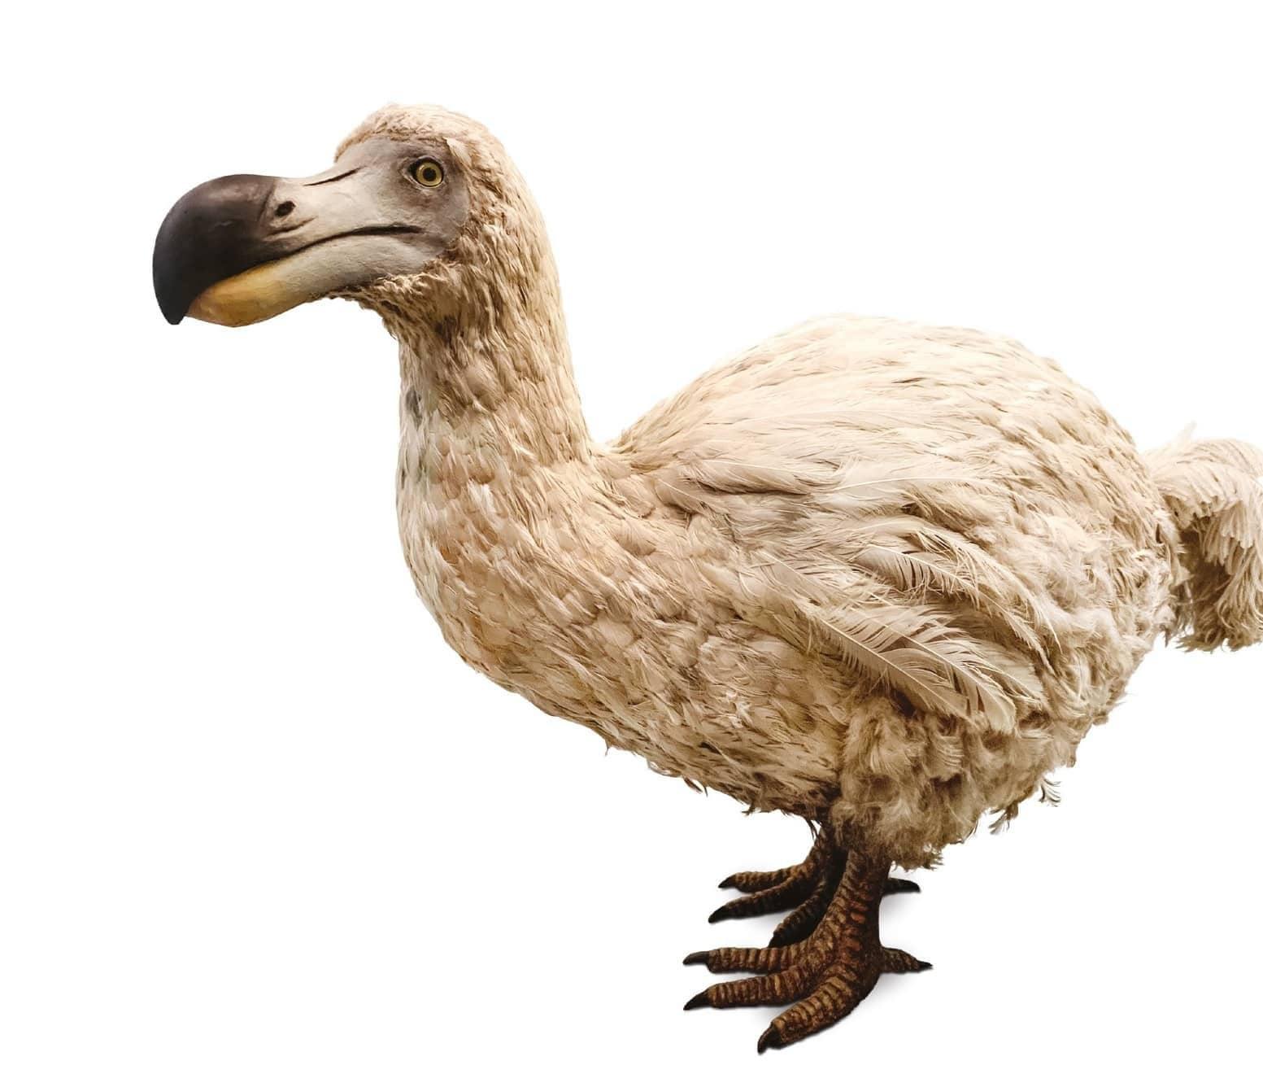
Basic Info
Dodo
Typical Mauritian Beach

Slide 6
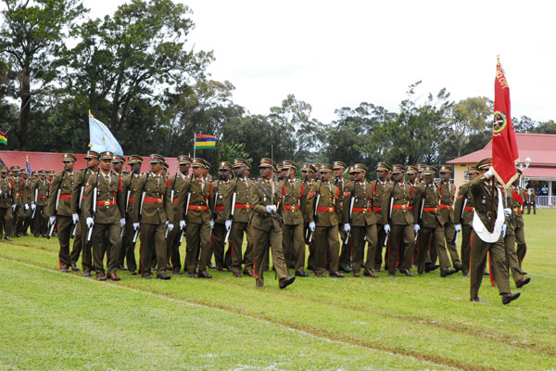
Basic Info
“We’ll do it what is it?”
Typical Mauritian Beach

Slide 7
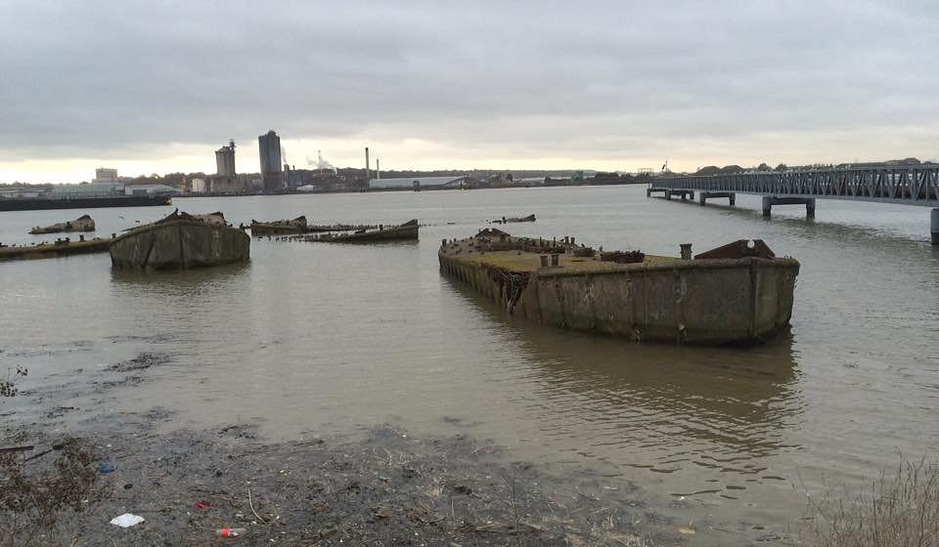
Basic Info
Typical Essex Beach

Slide 8
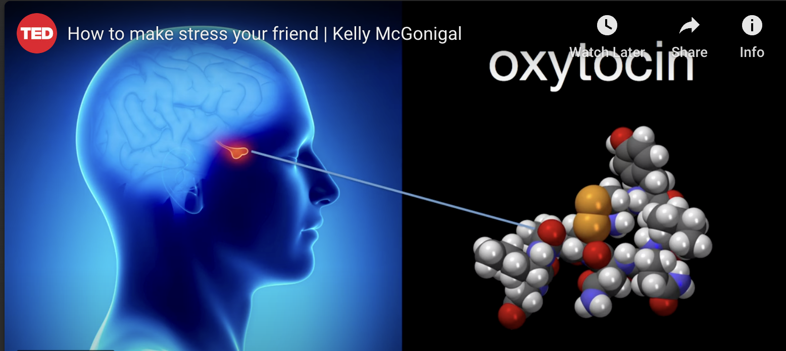
Basic Info
Tip 1: Remember that you’re very lucky
Tip 2: Relax and have fun!
How to make stress your friend
Kelly McGonigal
https://youtu.be/RcGyVTAoXEU
Typical Mauritian Beach

Slide 9
Context

Slide 10
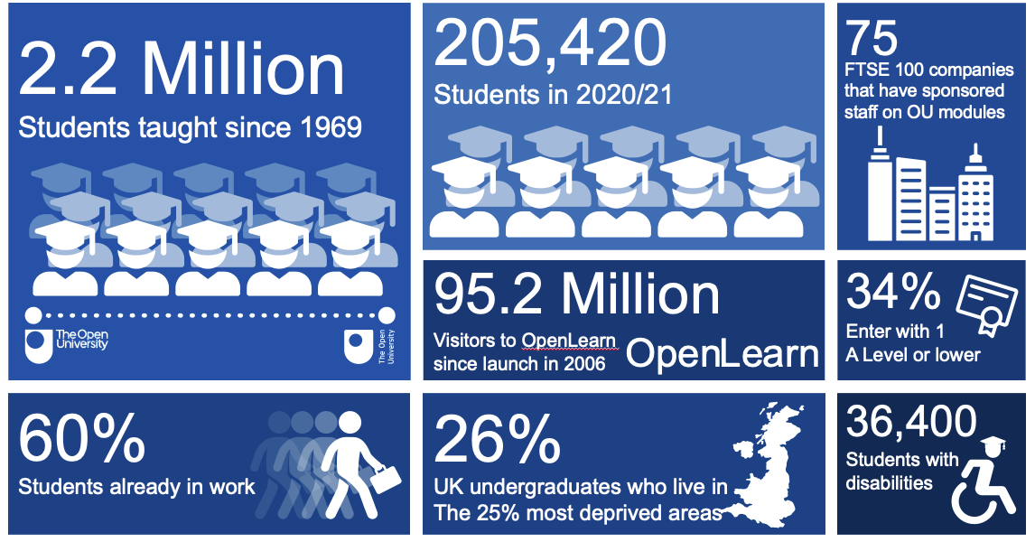
Open University Overview

Slide 11
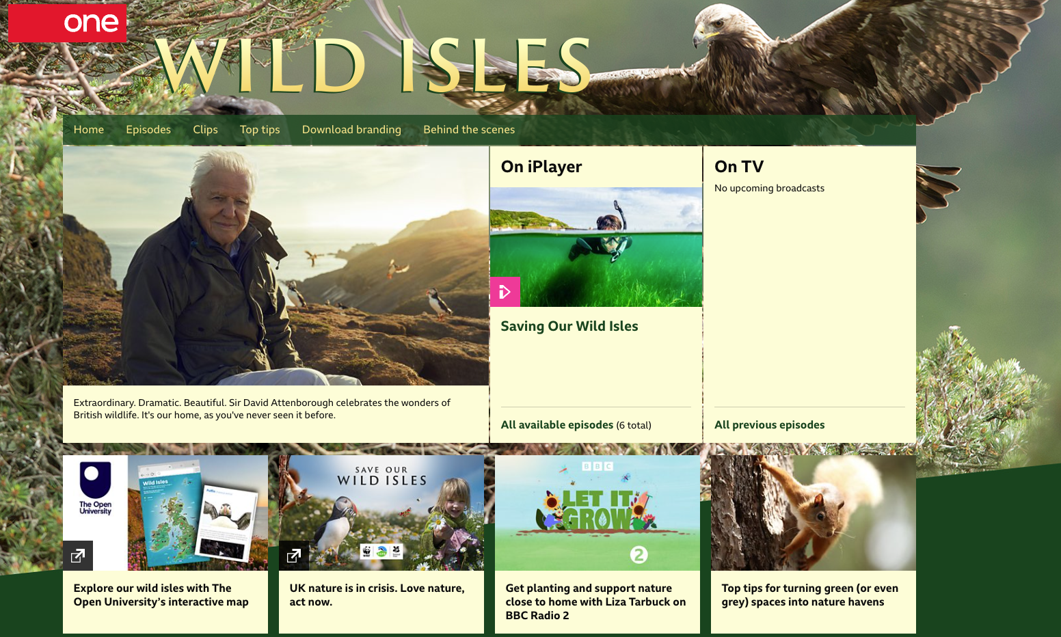
Open University Overview

Slide 12
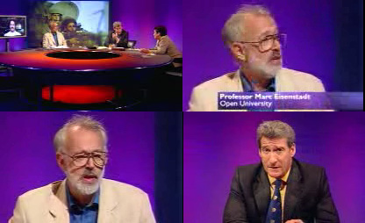
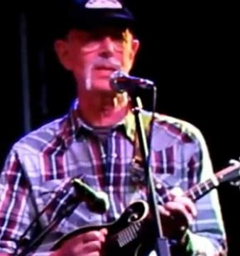
Tip 3: Importance of good PhD supervisor and mentors
Marc Eisenstadt’s Bluegrass Band
Marc Eisenstadt on main BBC News Programme
Tip 3a: Researcher who will become famous is best

Slide 13
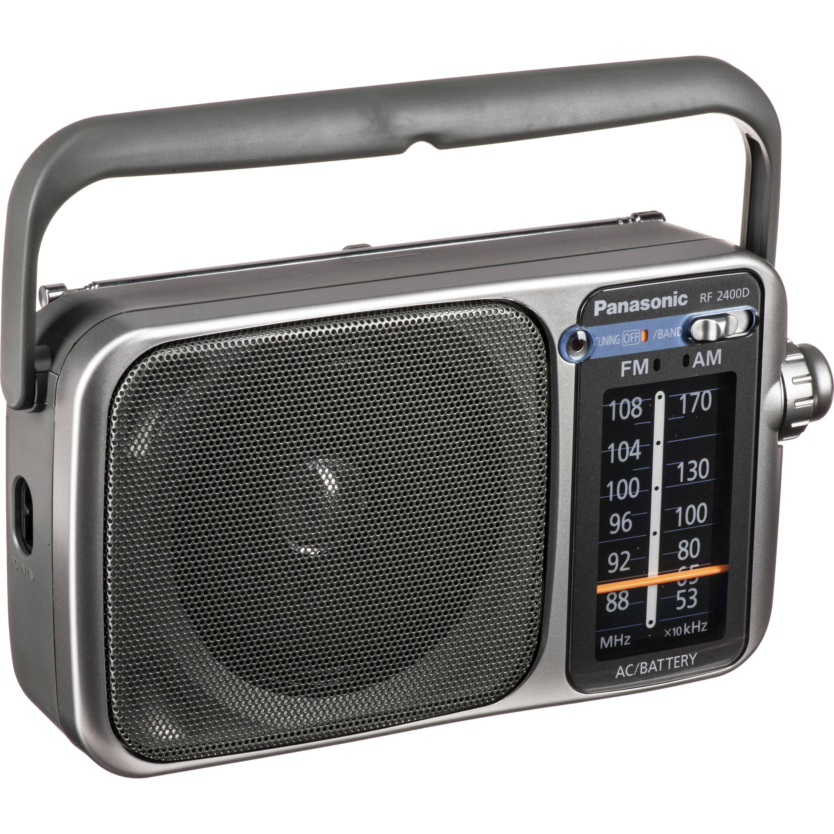
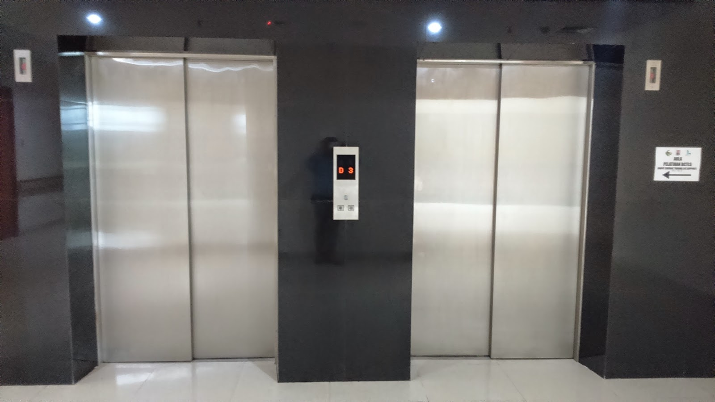

Tip 4: What’s the only question that one has to answer in a PhD?
So what?

Slide 14

Tip 5: Do the right thing

Slide 15
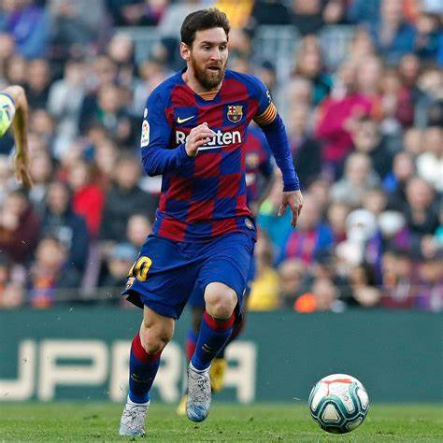
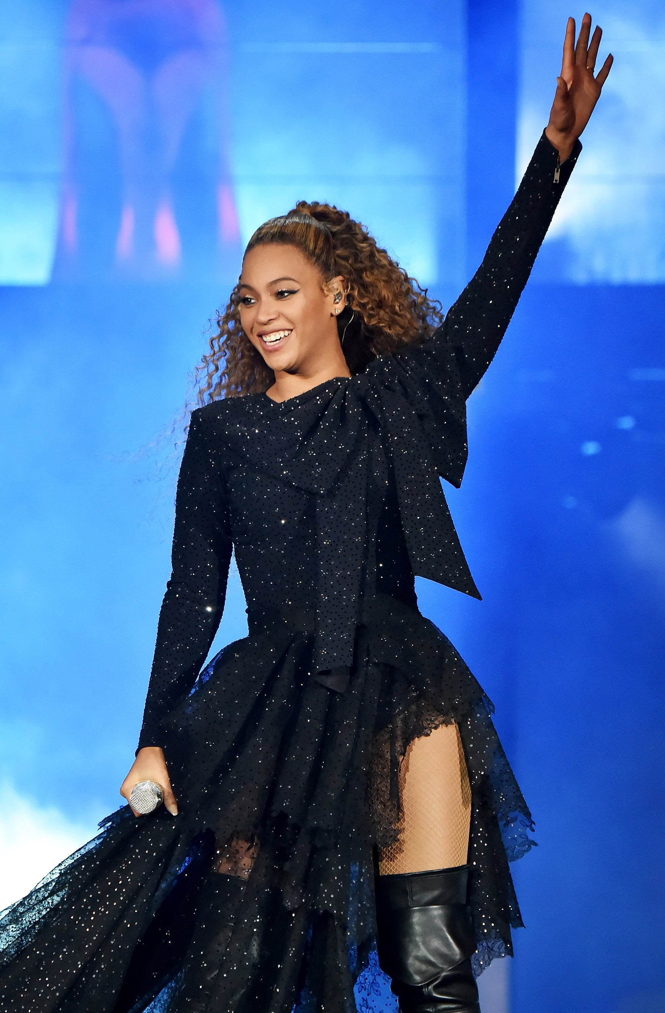
Tip 6: You’re only as good as your last performance
Messi
Beyonce

Slide 16
Criteria for a Research Assistant/Associate
A Master in Computer Science or a related field, or equivalent experience;
A PhD in Computer Science or related field or 2+ years equivalent in quality of achievement;
Experience in programming Java/C++/R/Python …
Ability to independently and proactively define solvable solutions to problems;
Deploy and maintain the solution in the production environment;
Ability to work in a team, contribute to code review, knowledge of working with a versioning system (e.g. GIT);
Proven ability to fit into the OU’s Computer Science REF profile (depending on level and experience: publications, supporting income generation and non-academic impact);
Ability to quickly demonstrate understanding of the project aims and specific tasks as requested;
Ability to write technical reports and contribute to research papers;
Ability to pro-actively seek solutions to complex problems;
Fluency in English;
Team player;
Hard worker;
Ability to work to challenging targets.

Slide 17
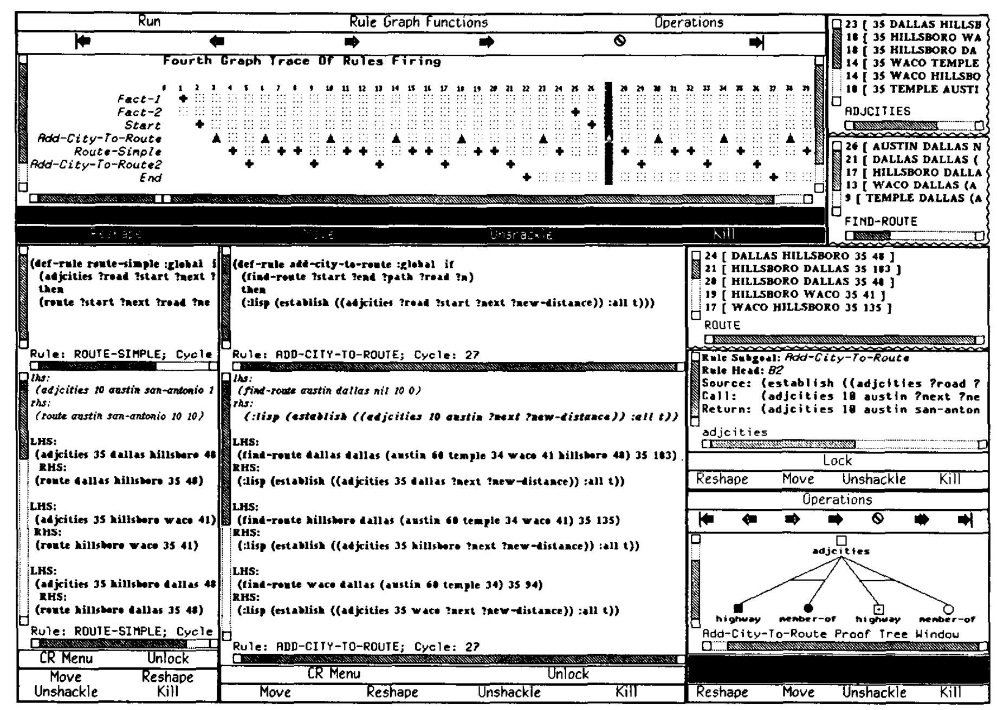
1990s Post PhD Party Time!
No PhD! ☺
No Administration! ☺ ☺
No Management! ☺
Transparent Rule Interpreter in KEATS
Knowledge engineering environment
Build things
Write papers

Slide 18
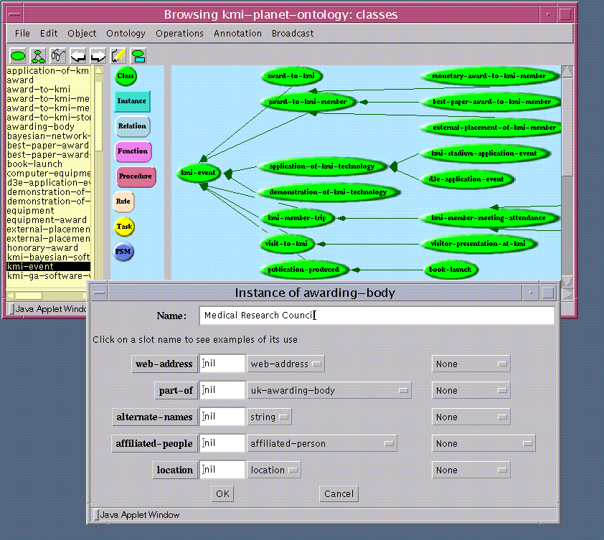
1990s Post PhD Party Time!
No PhD! ☺
No Administration! ☺ ☺
No Management! ☺
WebOnto
Ontologies via drag and drop
Build things
Write papers

Slide 19
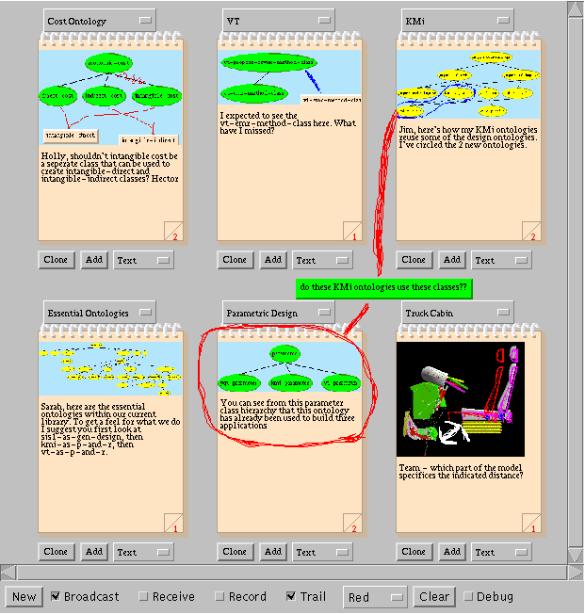
1990s Post PhD Party Time!
No PhD! ☺
No Administration! ☺ ☺
No Management! ☺
Tadzebao
Pinterest for Ontologies
Build things
Write papers

Slide 20
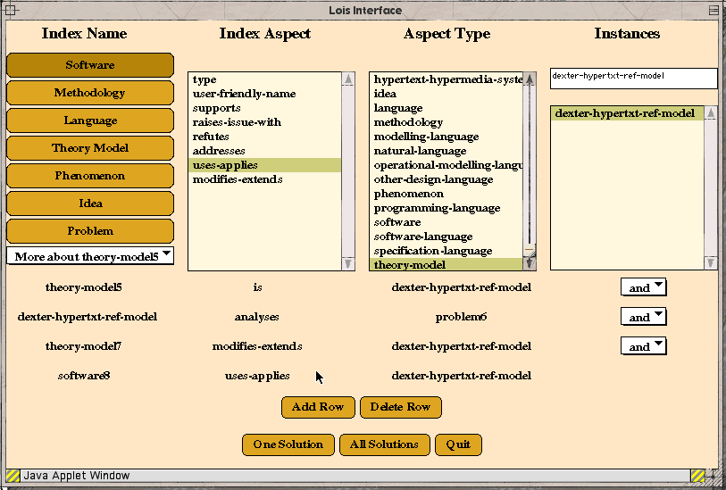
1990s Post PhD Party Time!
No PhD! ☺
No Administration! ☺ ☺
No Management! ☺
Lois
Instant ontology query interface
Build things
Write papers

Slide 21
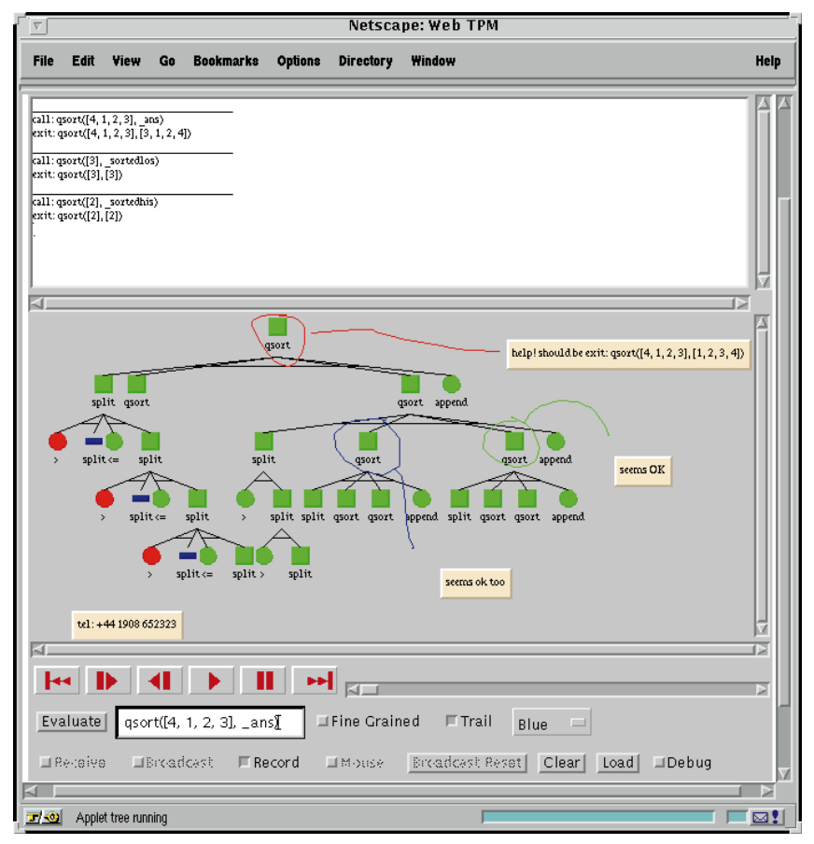
1990s Post PhD Party Time!
No PhD! ☺
No Administration! ☺ ☺
No Management! ☺
Internet Software Visualisation Lab
Synchronous and asynchronous sharing of semantic execution
Build things
Write papers

Slide 22
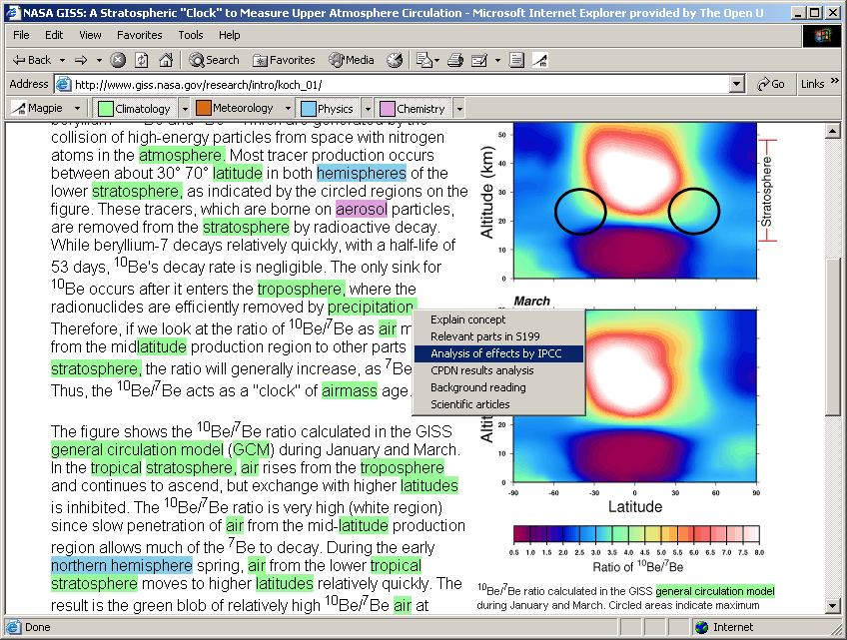
1990s Post PhD Party Time!
No PhD! ☺
No Administration! ☺ ☺
No Management! ☺
Magpie
Semantic Web Browser
Build things
Write papers

Slide 23
Possible Research Career/Lab Strategy with Mitigations
Do Good Work
drink coffee
Hype work
Attract Funding
Disseminate Work
Go drinking with funders
Tip 7: Follow the first part; reflect on the second

Slide 24

Tip 8: Beware of metrics (e.g. h-index)

Slide 25

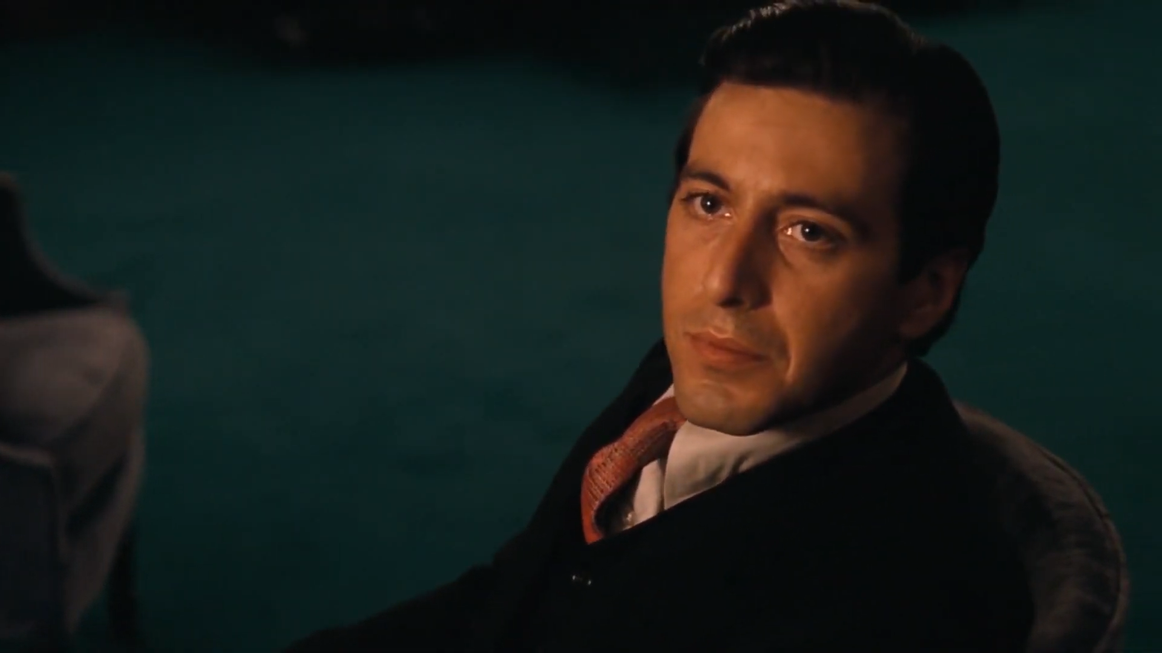
Tip 9: Rules for Going to Meetings
Only speak when you have something to say
Its only business
Never ever go against the family
Good overview of Trust
https://youtu.be/PTo9e3ILmms?si=6VUJMf_WxObGgywD
First VITAL Consortium Meeting

Slide 26
Professorship Criteria at the Open University (1/2)
Key criteria: Research
a) High quality scholarly outputs with significant authorship contributions. Total outputs will be considered but the Committee will have particular regard to trajectory as exemplified in at least four outputs (identified by the candidate) in the most recent 6 year period representing work recognised as internationally excellent, with at least half world-leading (e.g. 3*/3*/4*/4* in 2014 REF terms)
b) External research income, attributable to the candidate, normally within the top quarter of the UK sector figure for the subject area in the most recent 6 year period (guidance will be issued on this benchmark)21.
c) Principal Investigator on three or more RCUK, EU and/or other grants won in competition with peer review and Co- Investigator on others22.
d) An excellent and extensive record of effective supervision of research degree students.
e) Evidence of very considerable reach and significance in public engagement with research, impact of pedagogic or subject- based research on teaching and learning, or impact beyond academia.
f) Evidence of external research profile, including at least two of: service on a national editorial board, national research committee or conference committee; prestigious national prize(s) or award(s).

Slide 27
Professorship Criteria at the Open University (2/2)
Key criteria: academic leadership
Leadership demonstrated at a strategic level in any context (teaching, research, knowledge exchange, service or management) meeting the following criteria:
a) Excellent and significant leadership with major, demonstrable results that have enabled others to succeed with achieving objectives.
b) Successful driving of major initiatives or changes within and beyond department or centre level.
c) Major contributions of analytical and strategic thinking that have solved problems within and beyond department or centre level.
d) Excellent mentoring, management or development of others, demonstrating support of others’ career development.
e) Active membership and significant, valued contributions to University-level groups, boards or committees or equivalent in external bodies.

Slide 28
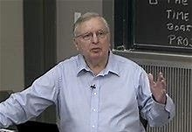
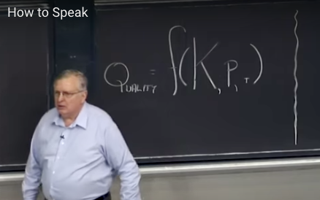
Tip 10: Learn to Speak
Patrick Winston
Performance = f(K,P,T)
Tip 11: you are programmable knowledge engine
https://youtu.be/Unzc731iCUY

Slide 29
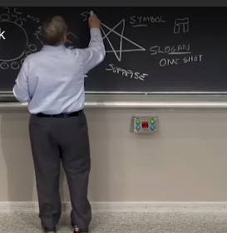

Tip 11: Above the Knowledge Level
Logo Level
Slogan Level
Just do it!
Knowledge Level
Symbols
https://youtu.be/Unzc731iCUY
A. Newell. The Knowledge Level. Artificial Intelligence, 18(1):87-127, 1982.

Slide 30
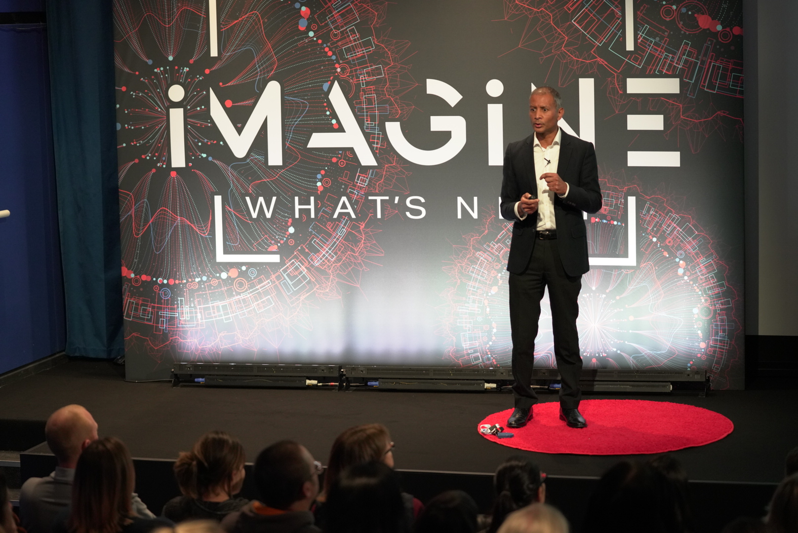
Most Challenging Talks (1/2)

Slide 31
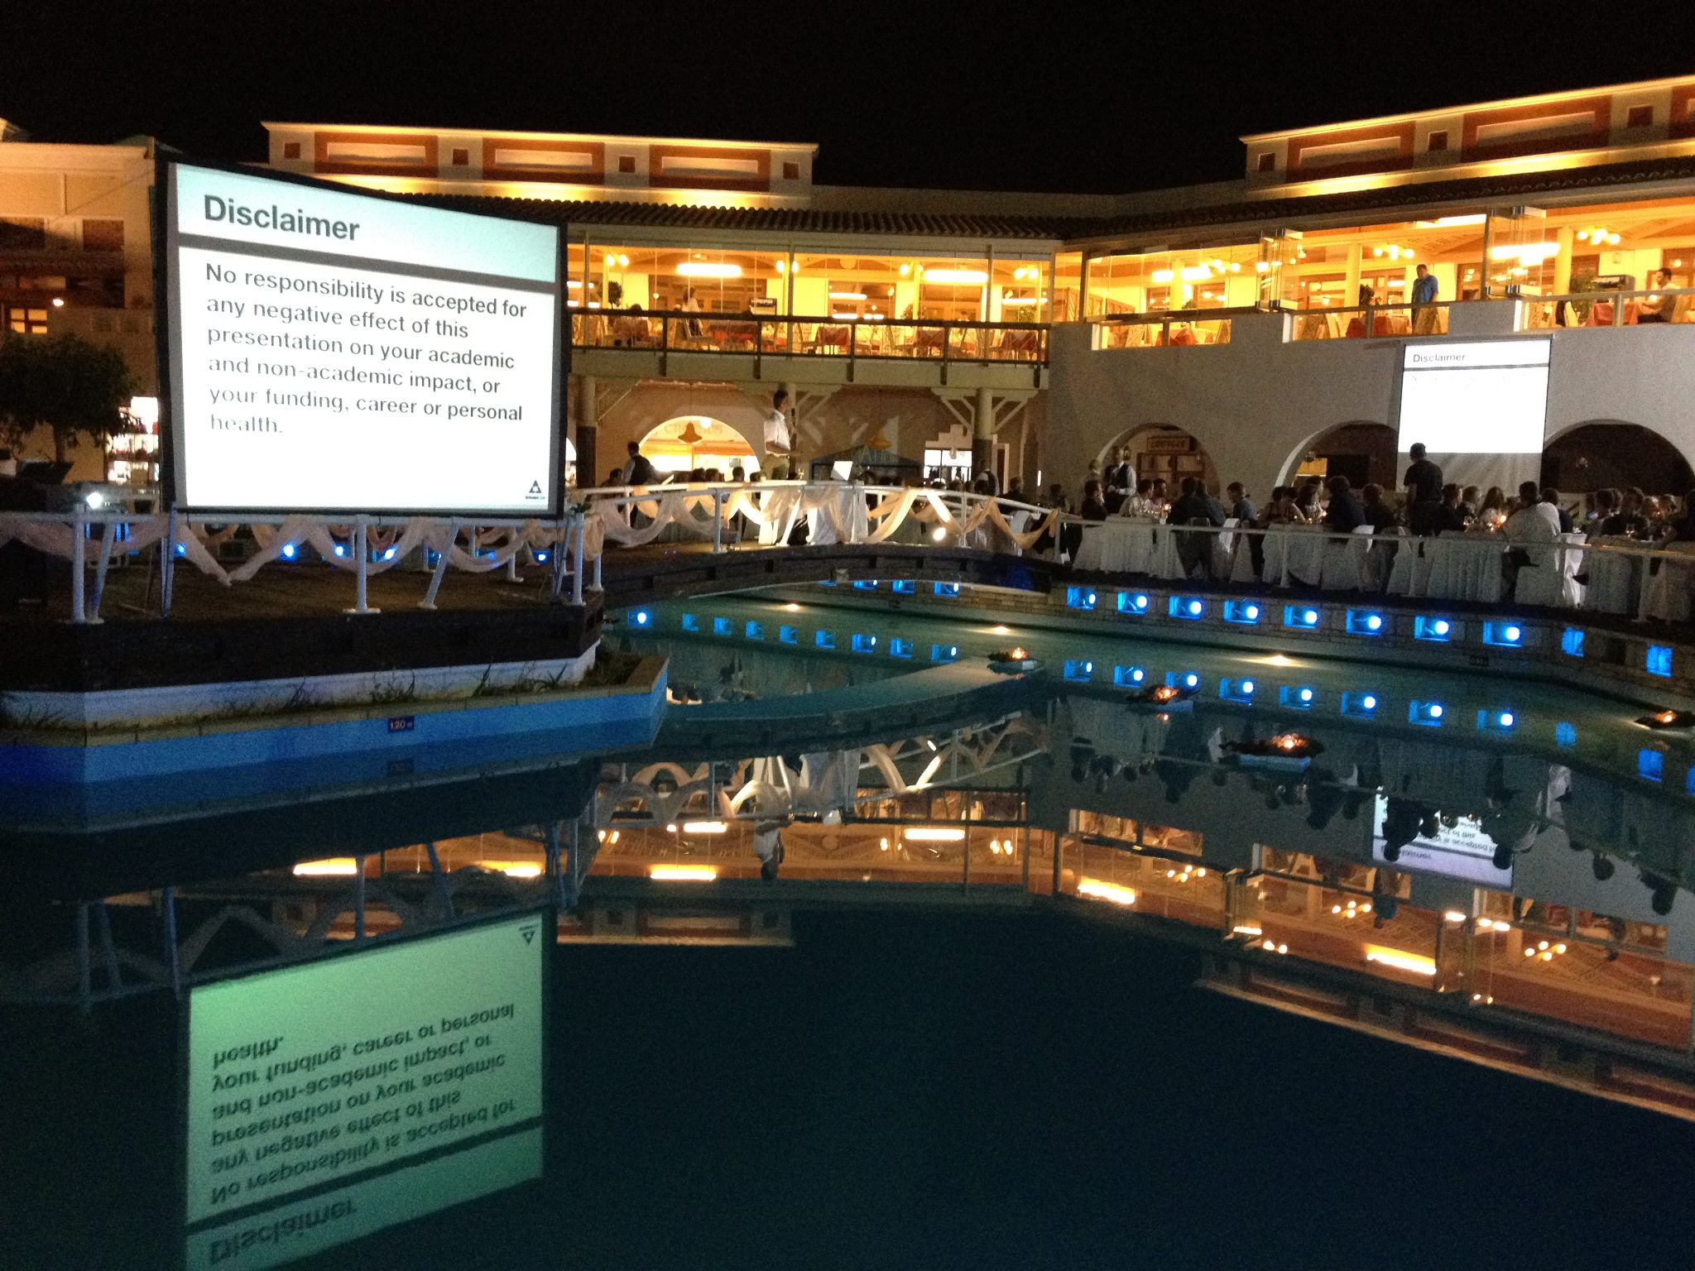
Most Challenging Talks (2/2)

Slide 32
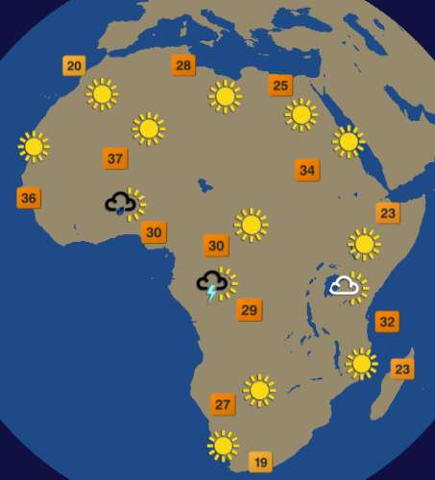
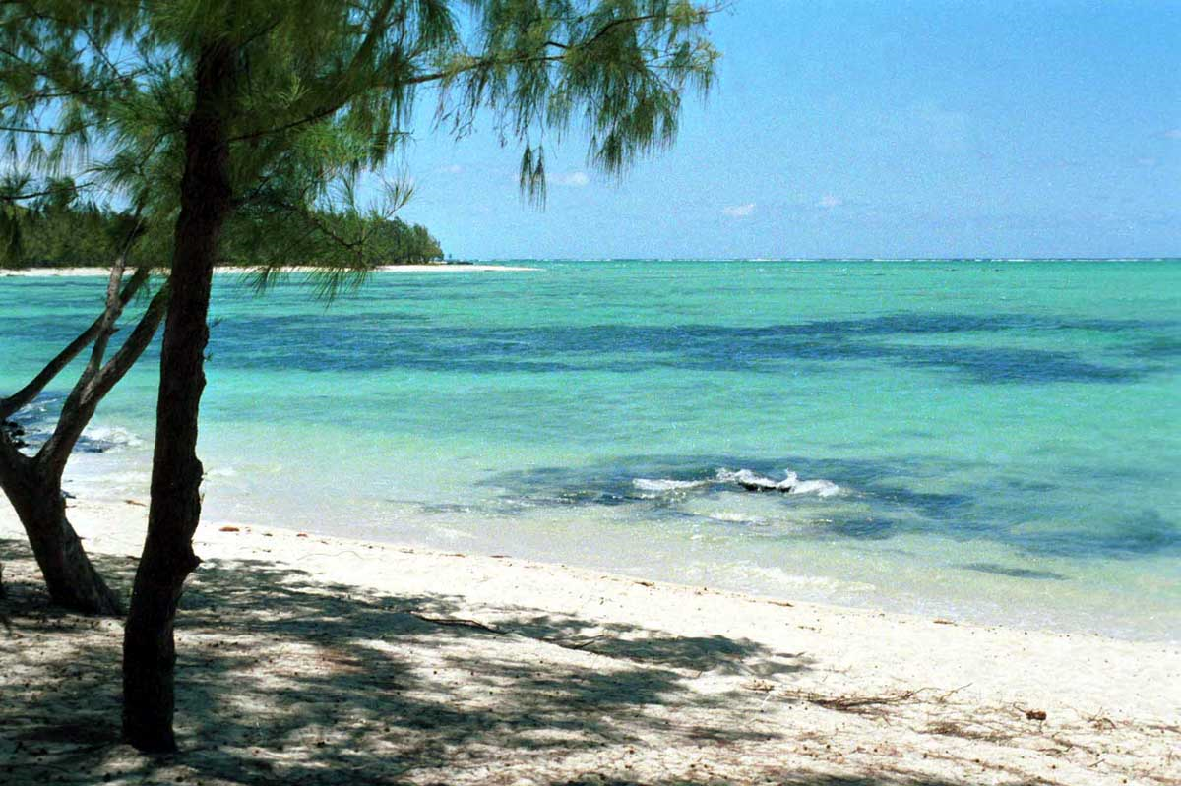
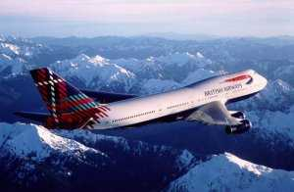


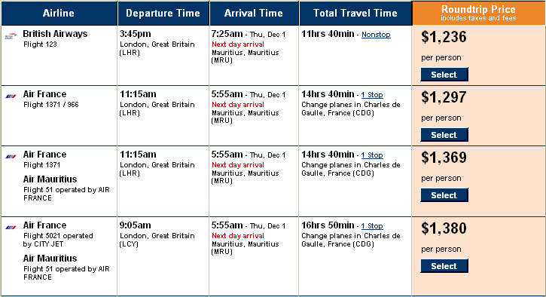
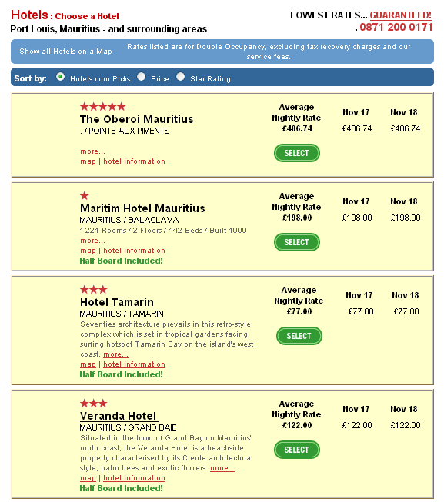
DIP Overview
Client
Services

Slide 33
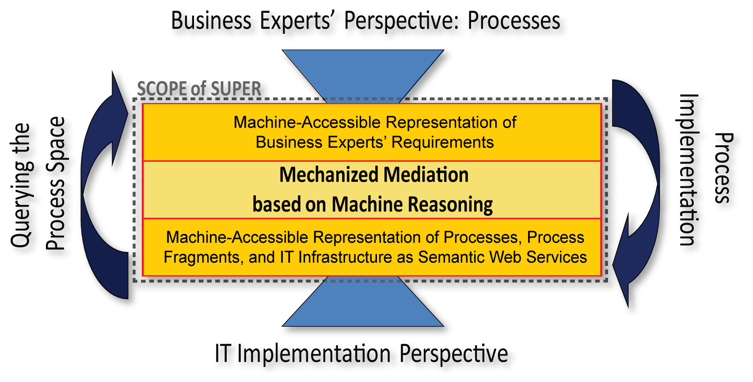
SUPER is about the
Critical IT / Process Divide
Notes:
33

Slide 34

SOA4All

Slide 35
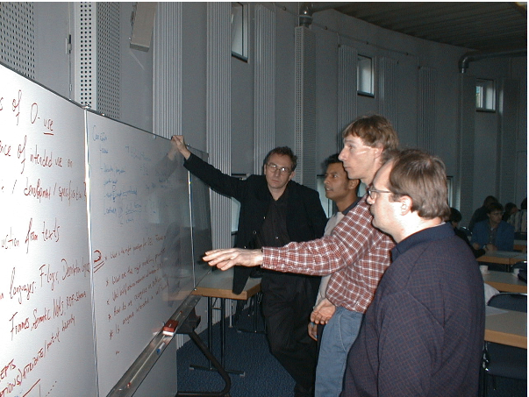
Tip 12: Play nice with the right researchers
You are the average of your 5 closest colleagues
This is me

Slide 36
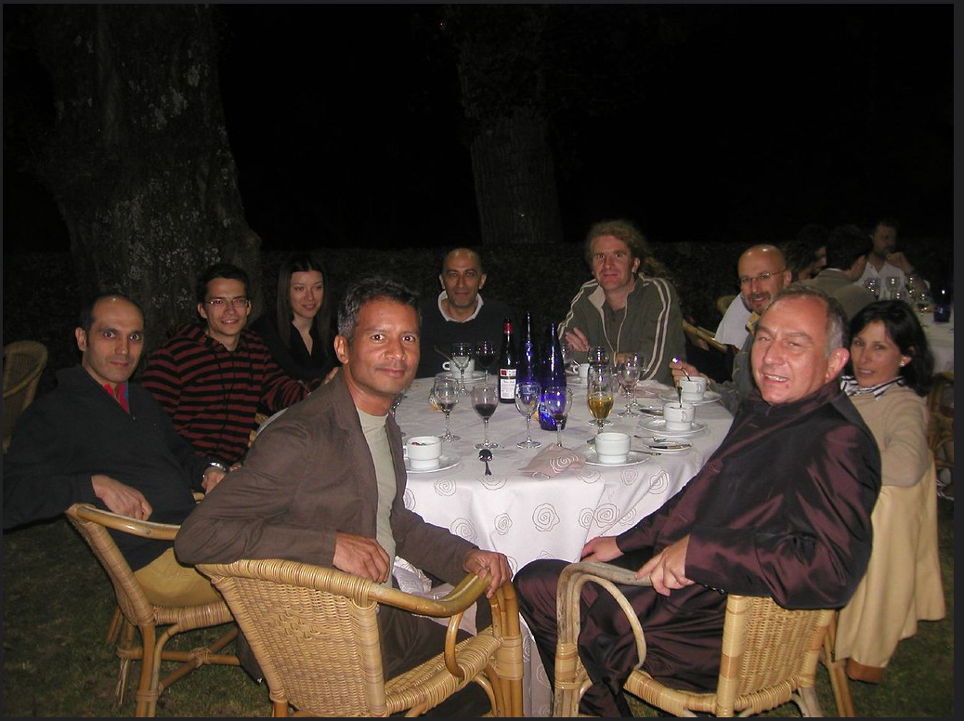
Network vs Career Graph
Career Level
Strength of Network

Slide 37
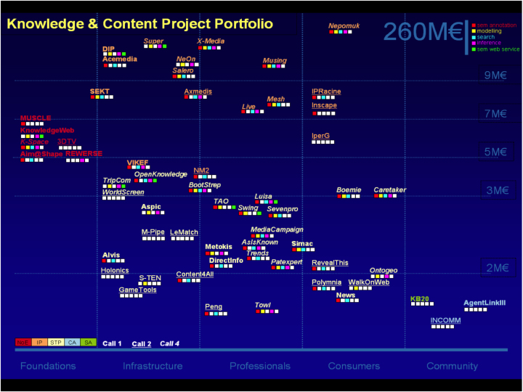
The €Billion Club

Slide 38
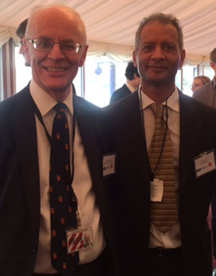
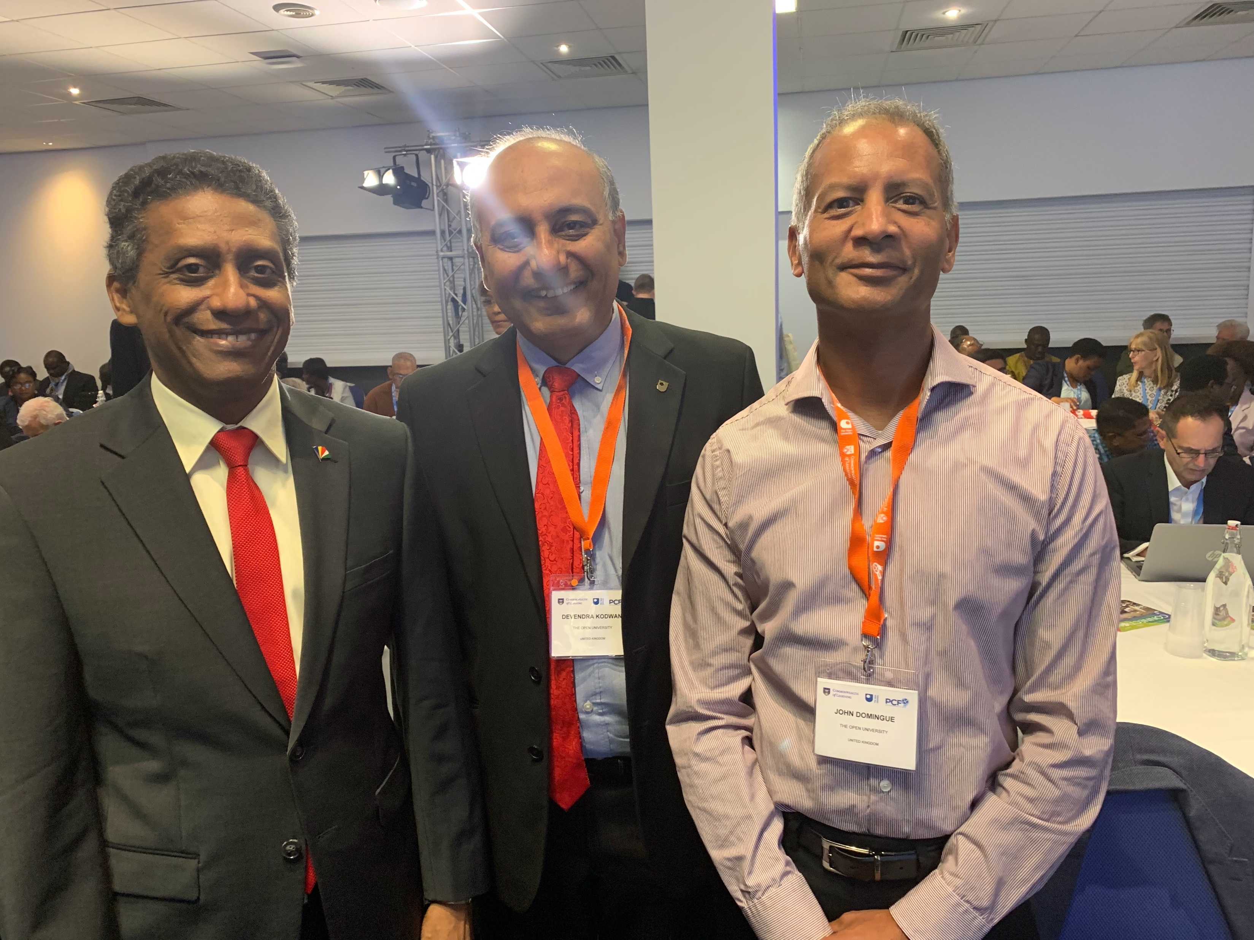
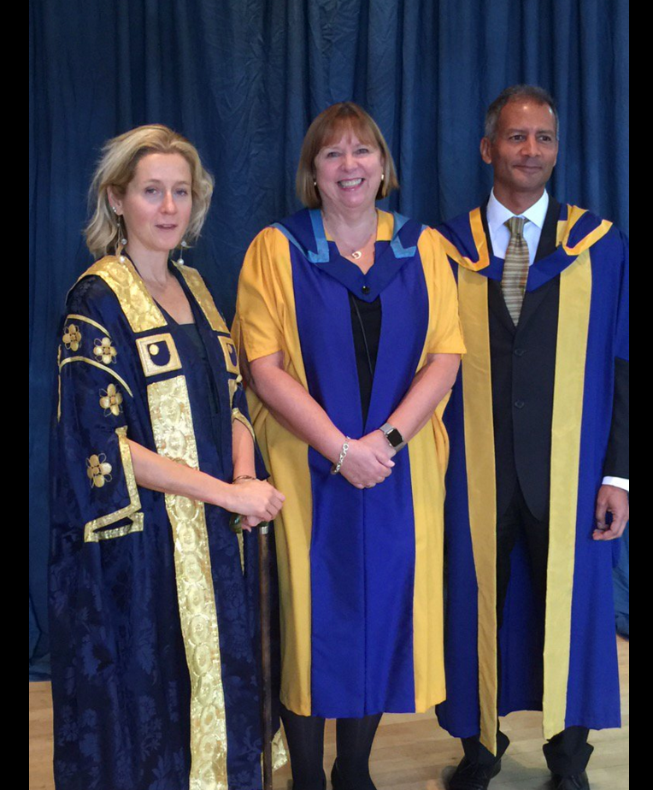
Who’s in your holiday photos?
President of the Seychelles
Lord Nugent from
UK House of Lords
Baroness Martha Lane Fox
Dame Wendy Hall
Who will be in your ISWC 2023 photos?

Slide 39
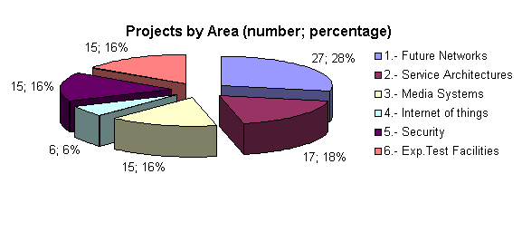


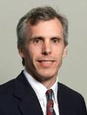
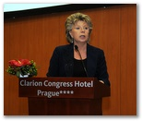
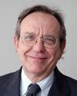
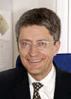
Future Internet Assembly
95 Projects In Challenge 1 have signed the Bled Declaration
= million 621 Euro
Call 5 will bring the budget to over 1B Euros
Bled, April, 2008
Madrid, December, 2008
Prague, May, 2009
Stockholm, November, 2009
Valencia, March, 2010
Slovenian
Minister
Czech
Ministers
VP Bell Labs
Commissioner Reding

Slide 40
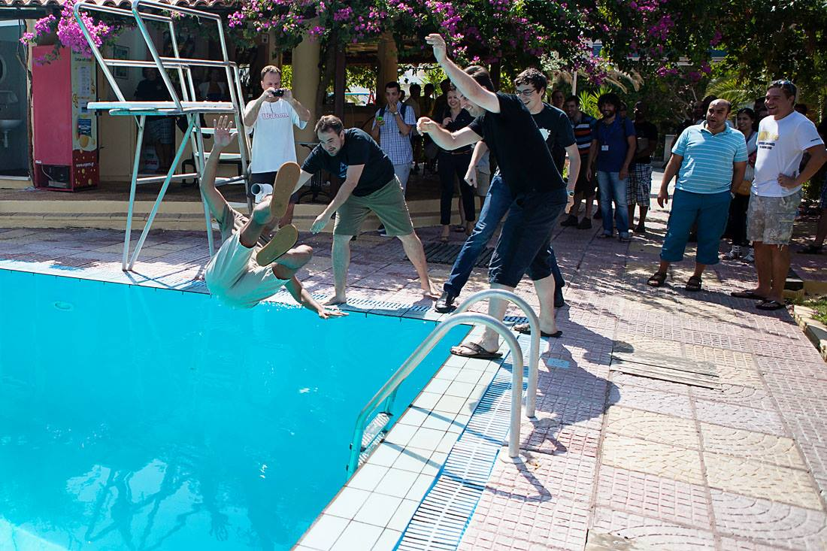
Tip 13: Better to have no ego
This is me

Slide 41
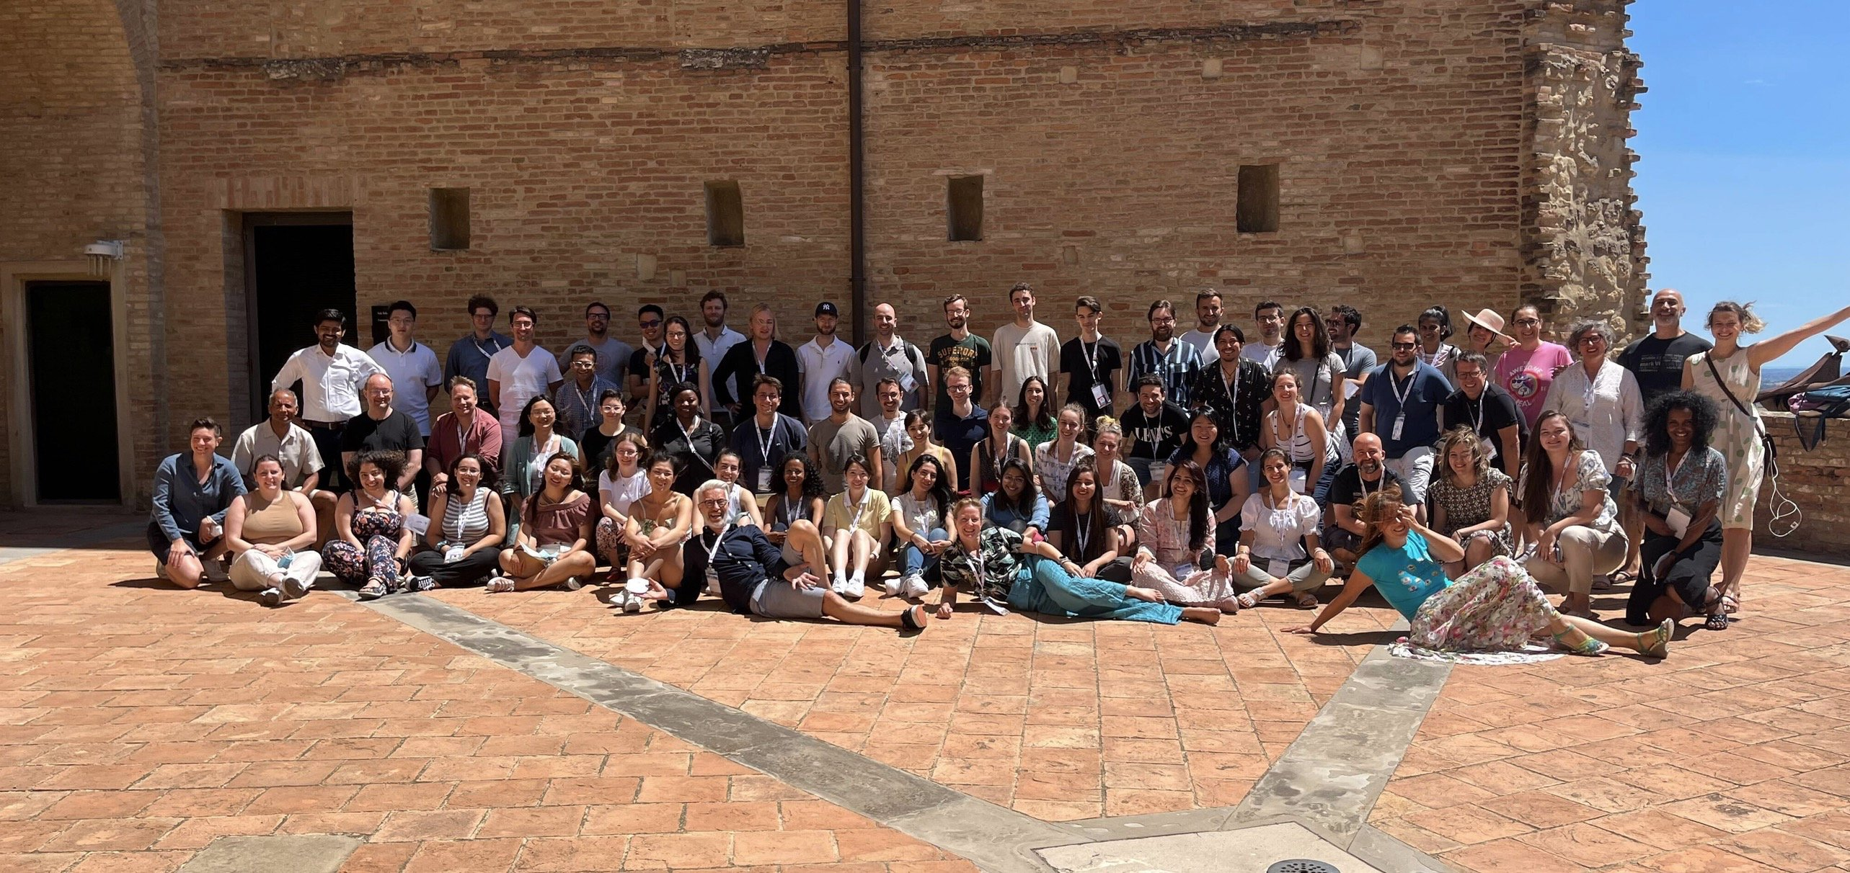
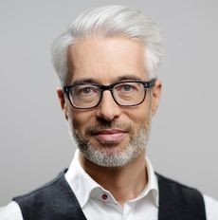
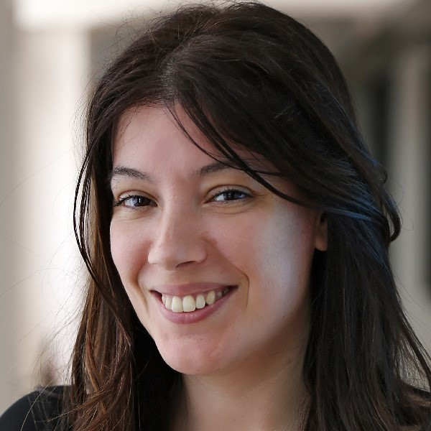
Tip 14: Go to GOOD Summer Schools
Harald Sack
Valentina Presutti
ISWS Summer School 2022
https://2023.semanticwebschool.org/

Slide 42
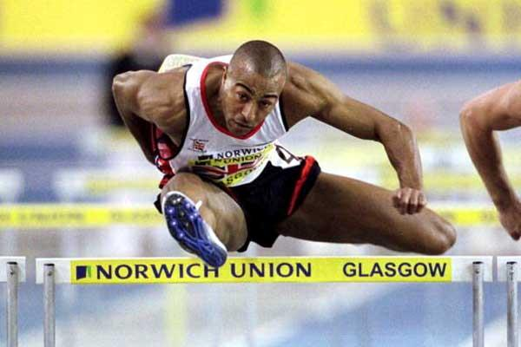
Tip 15: You will fail (a lot!) – it’s how you react that counts
2 x World Champion
Undefeated European Champion for 12 years
110m world record stood for 10 years
60m world record stood for nearly 27 years
Colin Jackson
Notes:
Colin Ray Jackson is a Welsh former sprint and hurdling athlete who specialized in the 110 meters hurdles¹². He won an Olympic silver medal, became world champion twice, world indoor champion once, and was undefeated at the European Championships for 12 years¹²³. Jackson's world record of 12.91 seconds for the 110m hurdles stood for over 10 years and his 60 meters hurdles world record stood for nearly 27 years¹². After retiring, he became a sports commentator for BBC and is a well-known face on British television³.

Slide 43
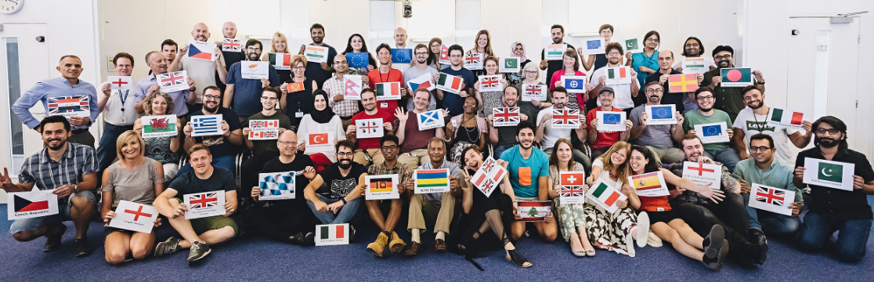
Tip 16: Culture eats Strategy

Slide 44
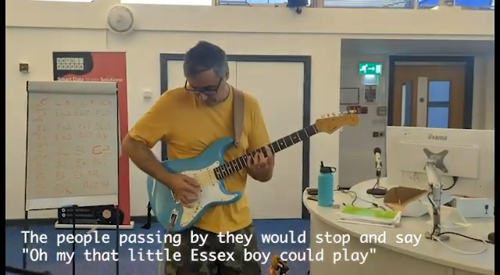
Tip 16: Culture eats Strategy
https://www.youtube.com/watch?v=U8oSfKZltHA

Slide 45
Summary
Tip 1: Remember that you’re very lucky
Tip 2: Relax and have fun!
Tip 3: Importance of good PhD supervisor and mentors
Tip 4: What’s the only question that one has to answer in a PhD
Tip 5: Do the right thing
Tip 6: You’re only as good as your last performance
Tip 7: Do Good Work personal/lab strategy (Follow the first part; reflect on the second )
Tip 8: Beware of metrics (e.g. h-index)
Tip 9: Rules for Going to Meetings (Godfather movie)
Tip 10: Learn to Speak
Tip 11: Above the Knowledge Level
Tip 12: Play nice with the right researchers
Tip 13: Better to have no ego
Tip 14: Go to GOOD Summer Schools
Tip 15: You will fail (a lot!) – it’s how you react that counts
Tip 16: Culture eats Strategy

Slide 46

Final Tip: Stay Curious, Stay Playful, Evaluate Rationally
Semantic Web
Knowledge Based Systems

Slide 47
Final Tip: Stay Curious, Stay Playful, Evaluate Rationally
Knowledge Graphs
Semantic Web

Slide 48
Final Tip: Stay Curious, Stay Playful, Evaluate Rationally
Generative AI?
Knowledge Graphs

